Slide 1



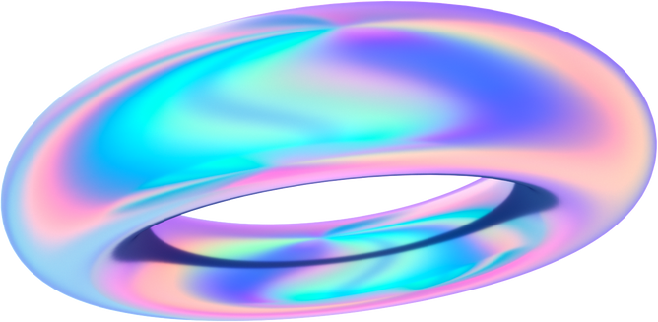

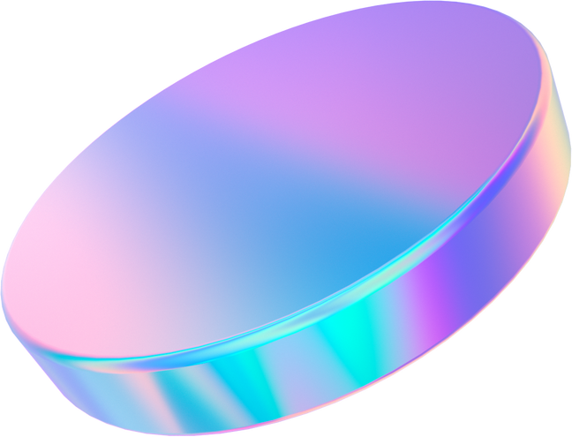

Egyptian Car Plates Reader
Supervised By: Dr:/ Mohammad Tawfik

Slide 2
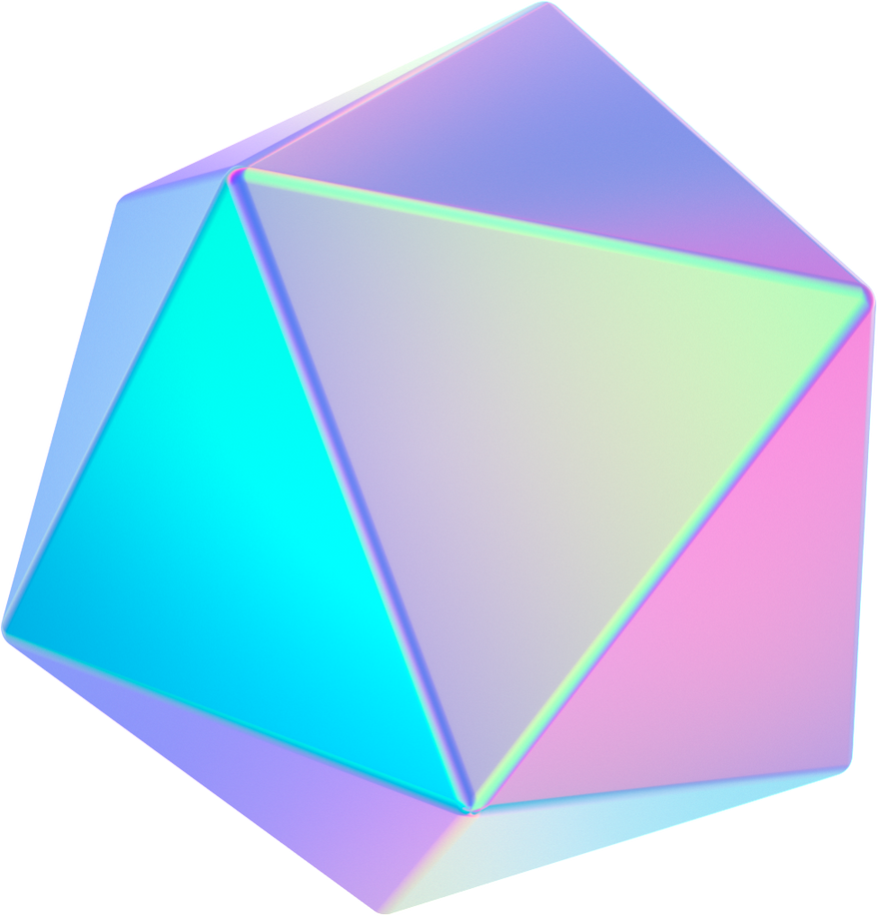


Problem Defintion
Currently, we have a problem in our university, where in order for a car to enter the gates and traverse through the uni grounds, a human intervention is required.
We aim to solve this problem with the powers of DeepLearning and Neural Networks, thus automating the whole process.

Slide 3
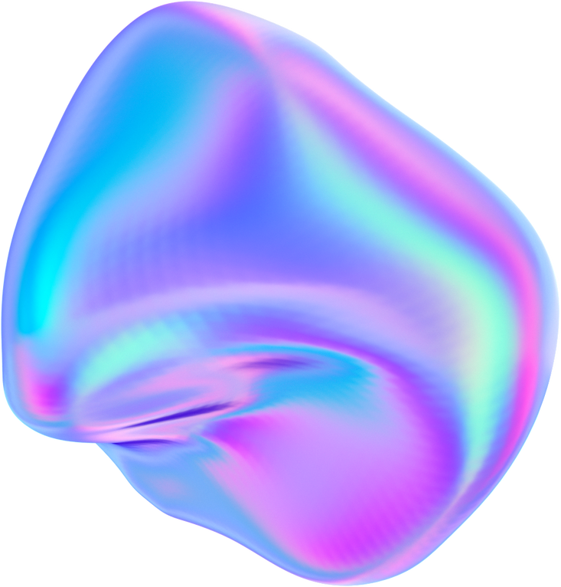


Our Journey
Model Arch.
Preprocessing
Results
Data Collection
Final System

Slide 4
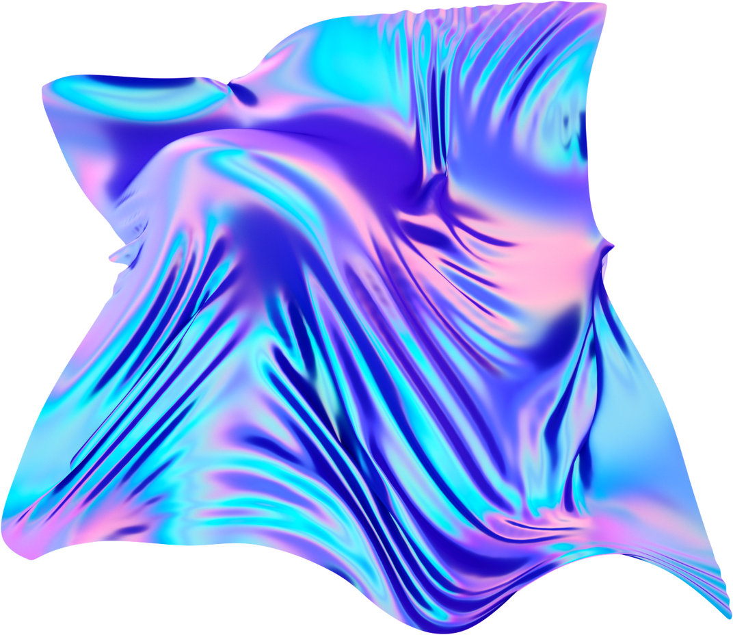



Collecting The Data

Slide 5
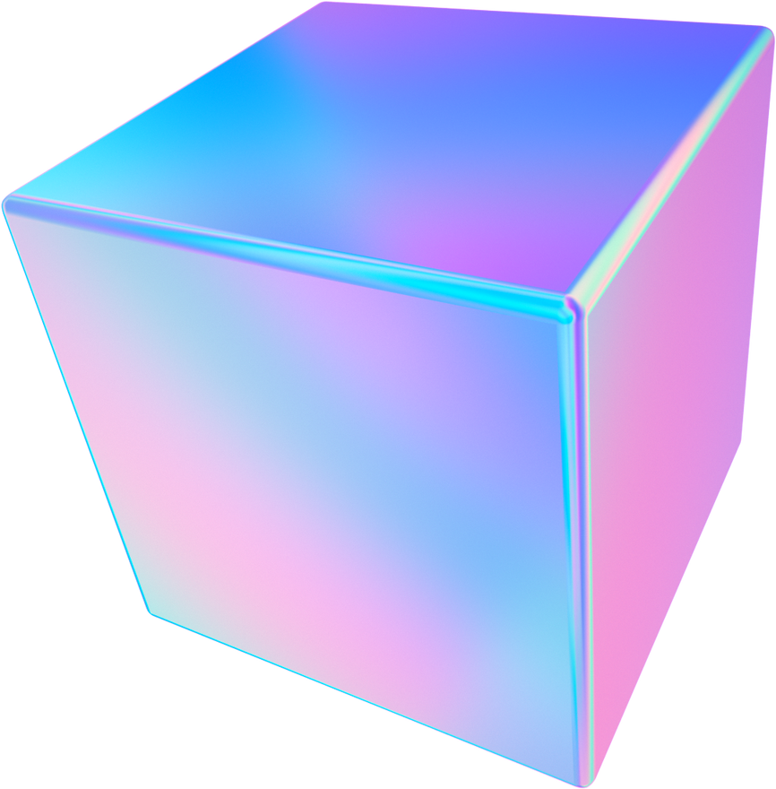

We wandered the streets to begin our data collection journey and took about 300 pictures for our model to play around with.

Slide 6
We also obatined pictures from online public datasets, totaling about 1200 pictures

Slide 7

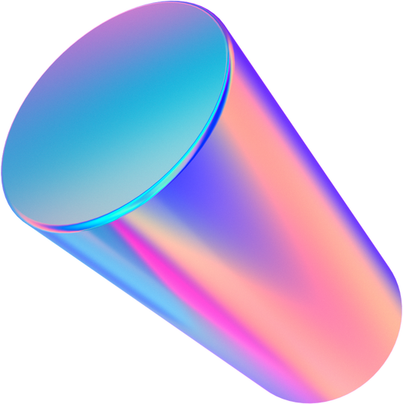

Preprocessing

Slide 8
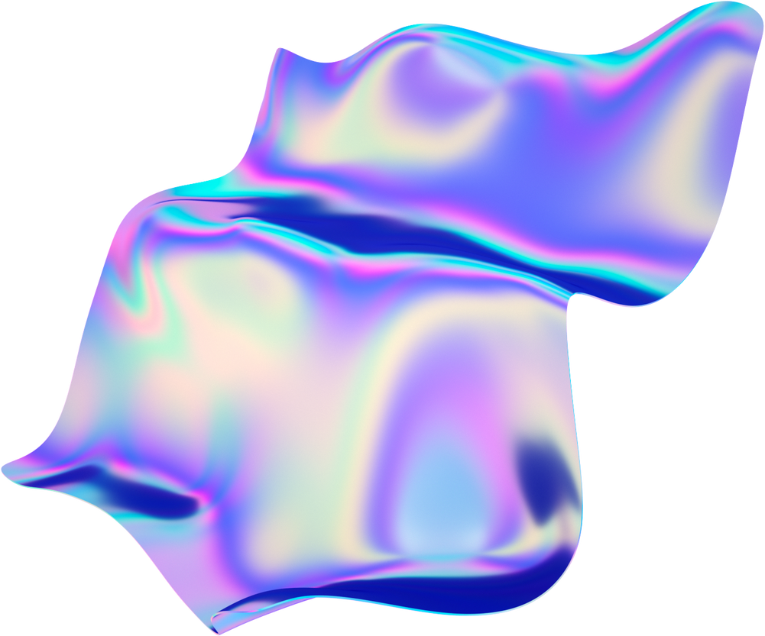
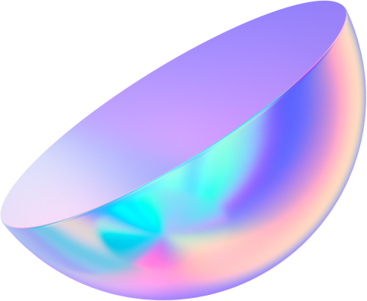
PRE-Preprocessing
Labeling
Pooling
Cleaning
Firstly, we labled our pictures
Then, we pooled our dataset with our colleagues
Finally, we fixed the others labels and removed duplicates

Slide 9
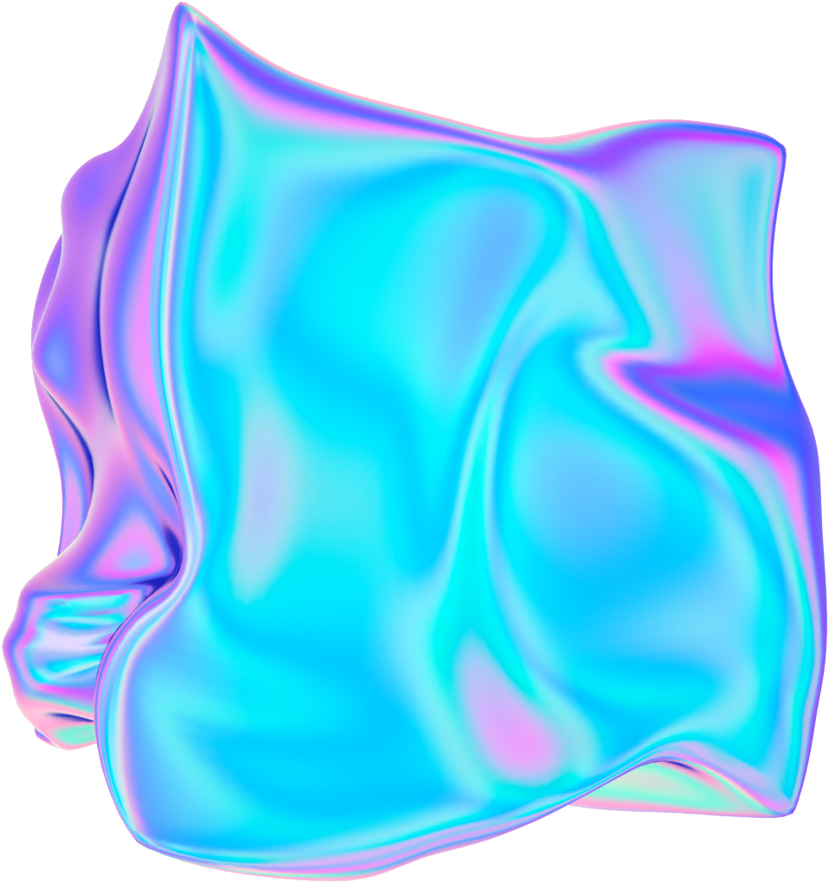



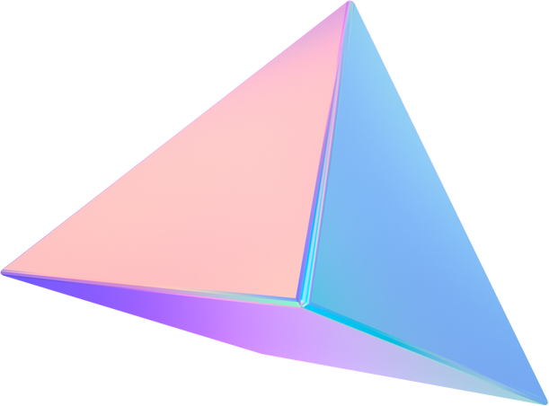


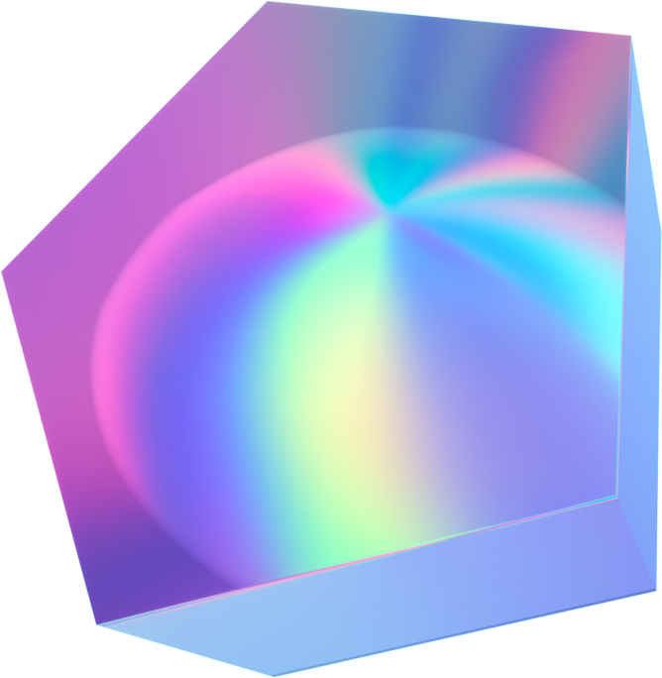
Preprocessing
1
2
3
STEP
STEP
STEP
We mapped Arabic characters to English ones
We standardized the data
Augmentation
Rotation,
Random Erasing
and Distortion
(128 x 64) pixels and turned it into grayscale

Slide 10
Preprocessing
1
2
3
STEP
STEP
STEP
We mapped Arabic characters to English ones
We standardized the data
Augmentation
Rotation,
Random Erasing
and Distortion
(128 x 64) pixels and turned it into grayscale

Slide 11
Preprocessing
1
2
3
STEP
STEP
STEP
We mapped Arabic characters to English ones
We standardized the data
Augmentation
Rotation,
Random Erasing
and Distortion
(128 x 64) pixels and turned it into grayscale

Slide 12

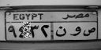
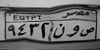
Augmentation
Rotation
Random Erasing
Distortion

Slide 13



Model Archticture

Slide 14

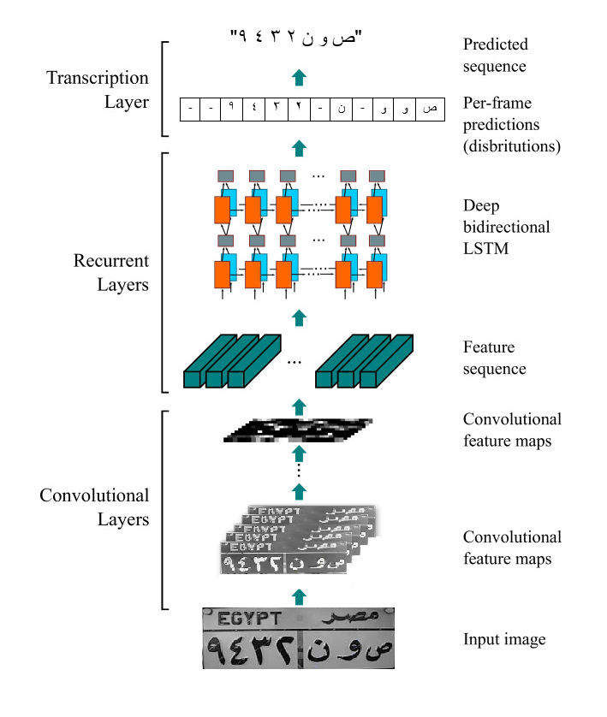

The architecture consists of three parts:
Convolutional Layers
Reccurent Layers
Transcription Layer

Slide 15

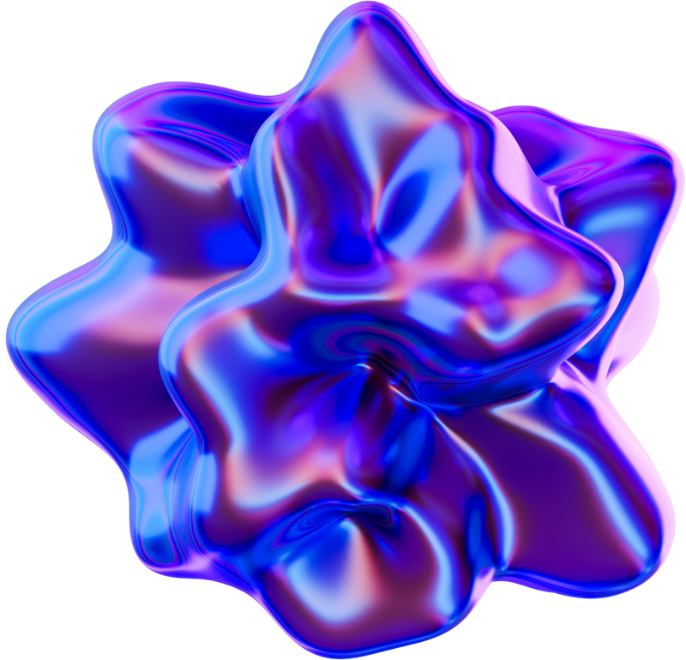
Convolutional Layers
The architecture of the convolutional layers is based on the VGG architecture.
The convolutional layers automatically extract a feature sequence from each input image.

Slide 16
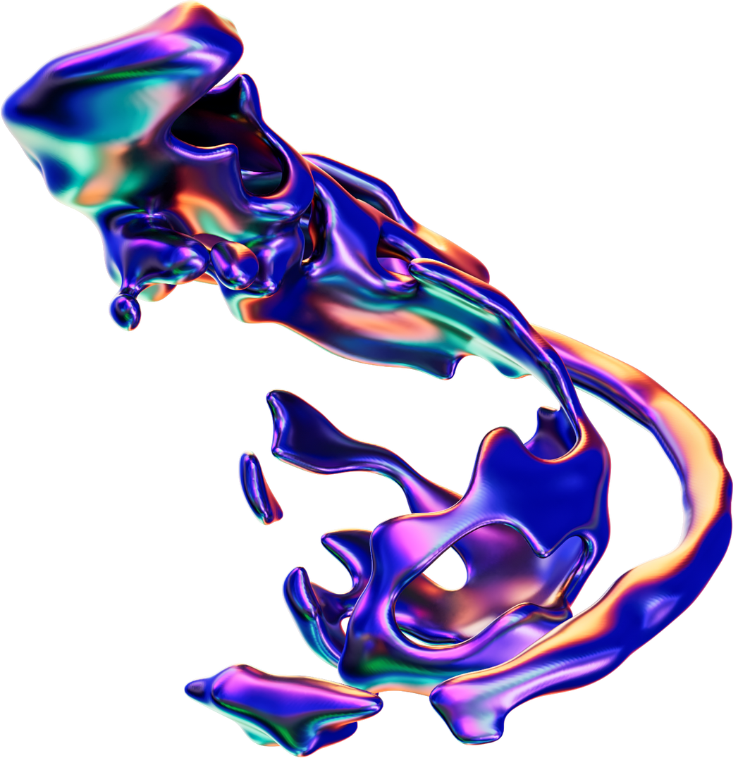
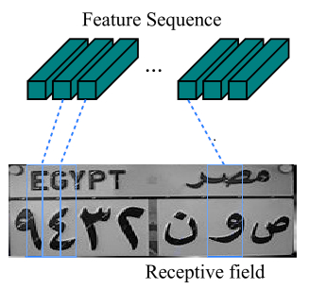

CNN output to RNN
Each vector in the extracted feature sequence is associated with a receptive field on the input image and can be considered as the feature vector of that field.

Slide 17


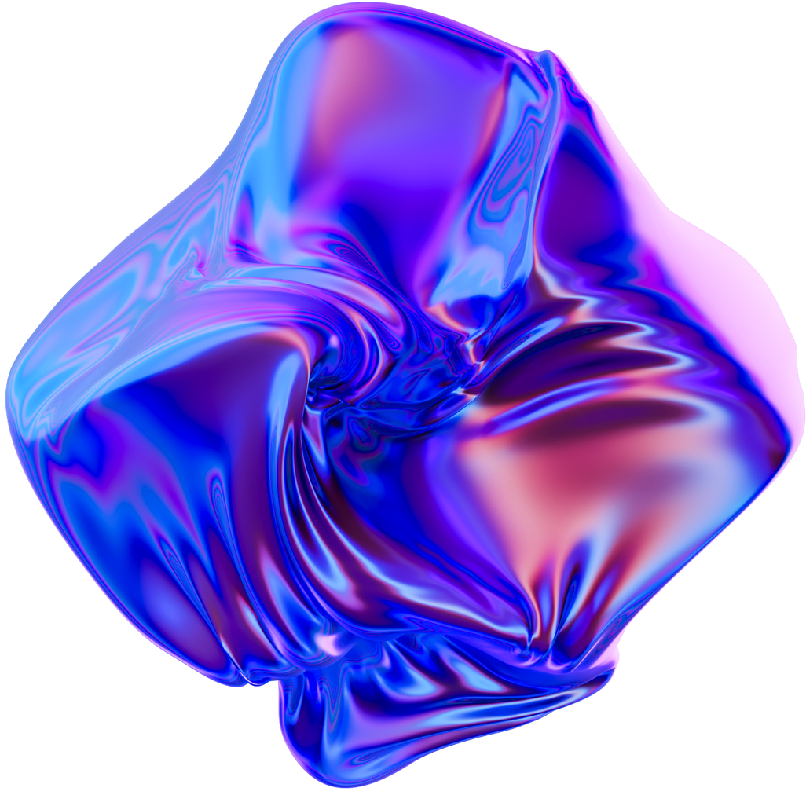
Recurrent Layers
A deep bidirectional Recurrent Neural Network is built on the top of the convolutional layers.

Slide 18
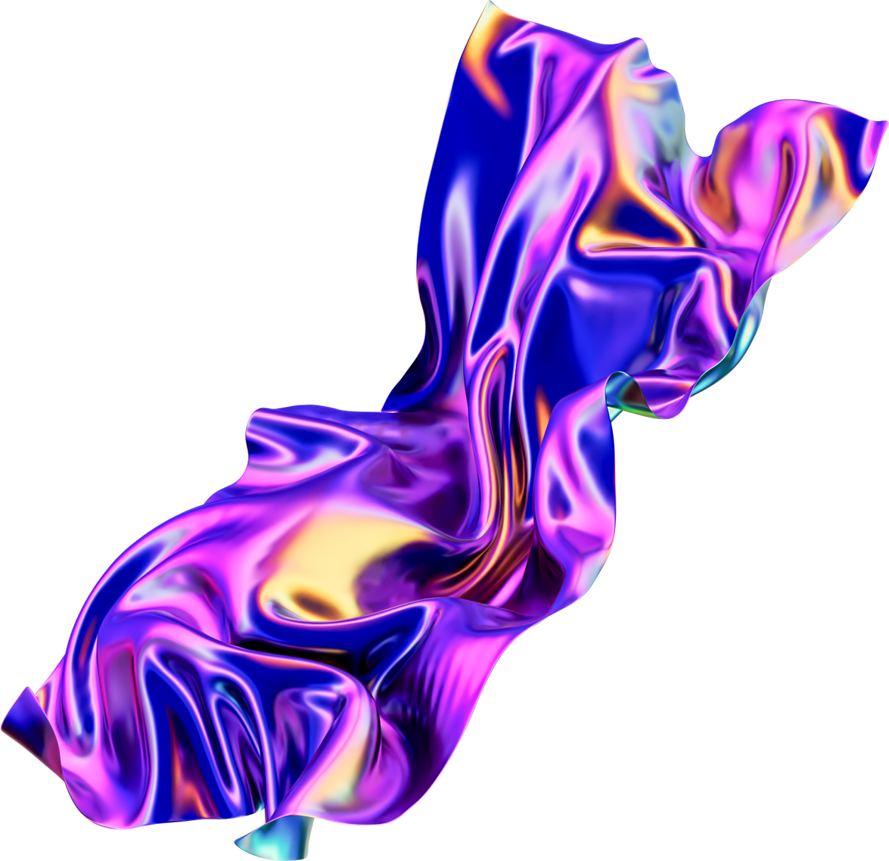


Transcription Layer
Transcription is the process of converting the per-frame predictions made by RNN into a label sequence.

Slide 19
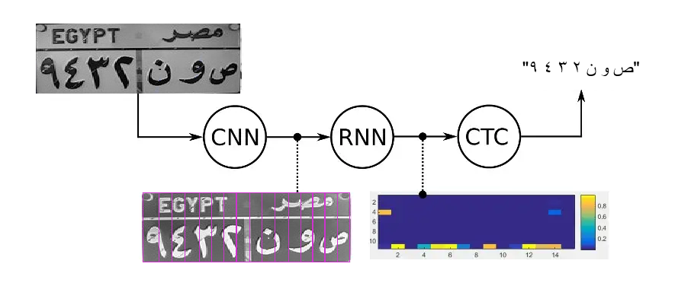

Loss Function
For the loss function, we used Connectionist Temporal Classification (CTC) as we only have to tell it the text that occurs in the image.

Slide 20
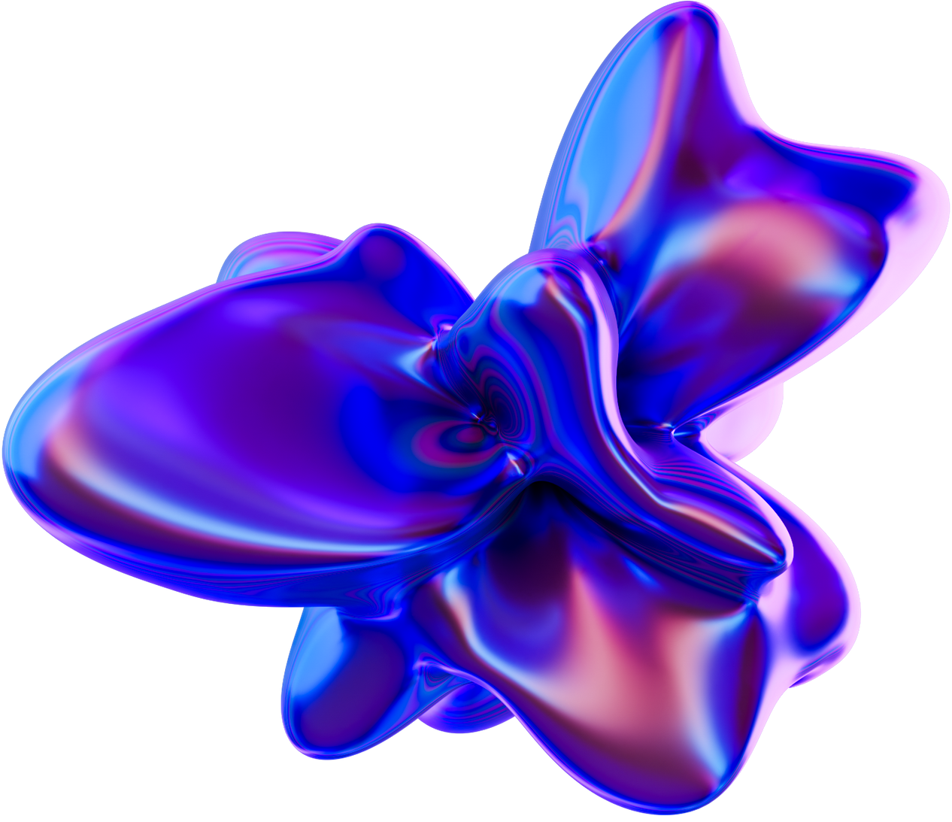


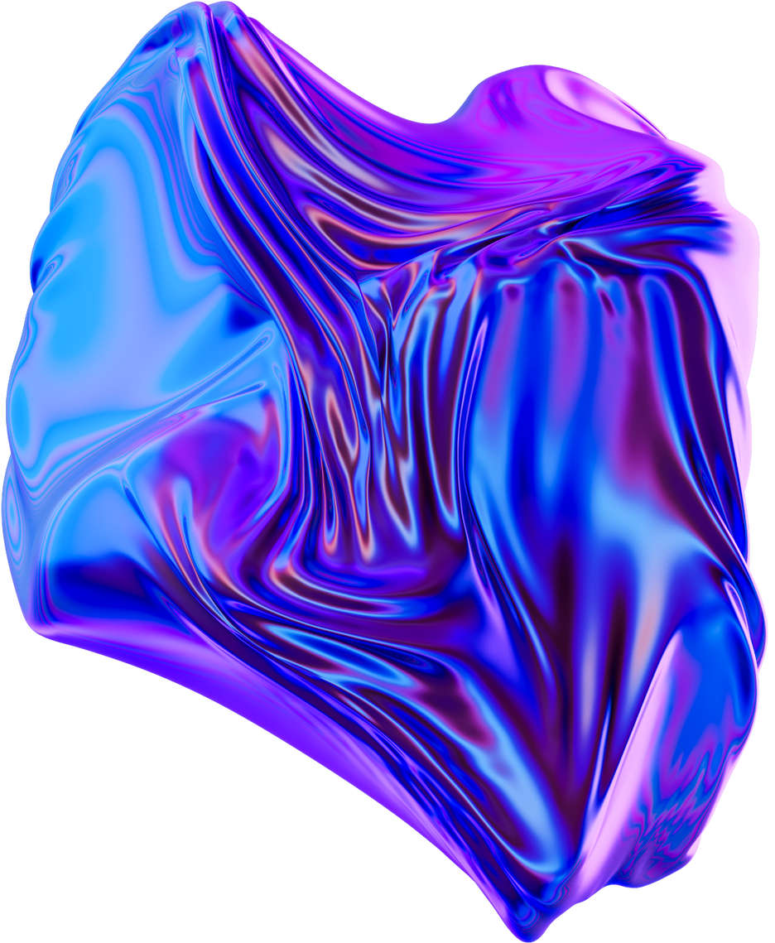
Optimizer
ADAM
SGD
ADADELTA
This optimizer is slow and hard to converge.
This optimizer is slow and hard to converge as well.
It's the fastest of the three of them with no compromises.

Slide 21
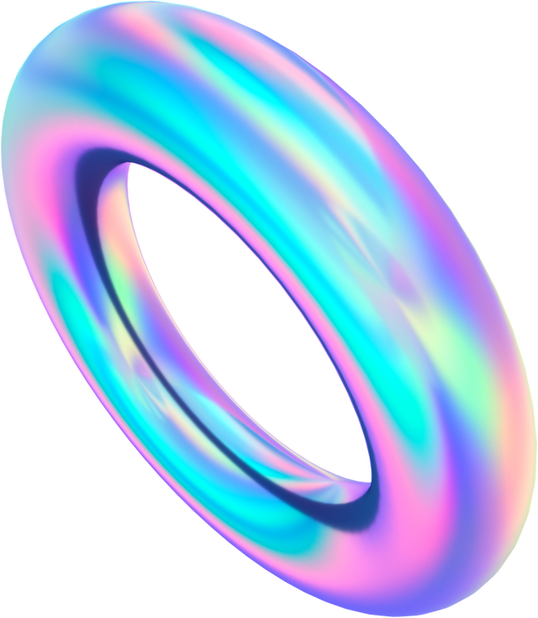
Training the model
Epochs = 50
Batch size = 8
Steps per epoch = 1243

Slide 22


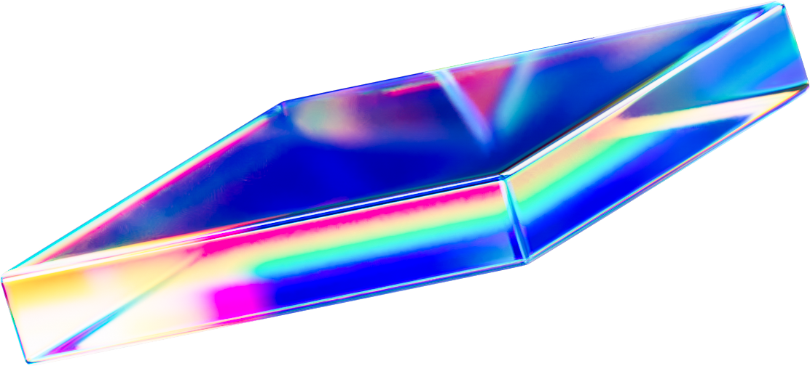
Results!

Slide 23
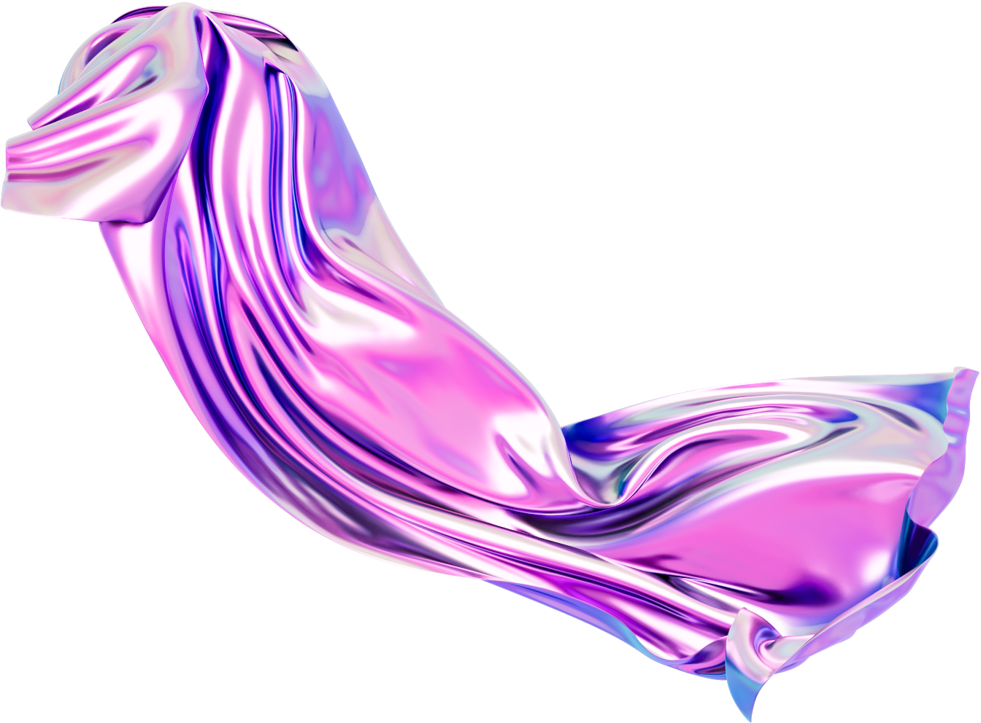
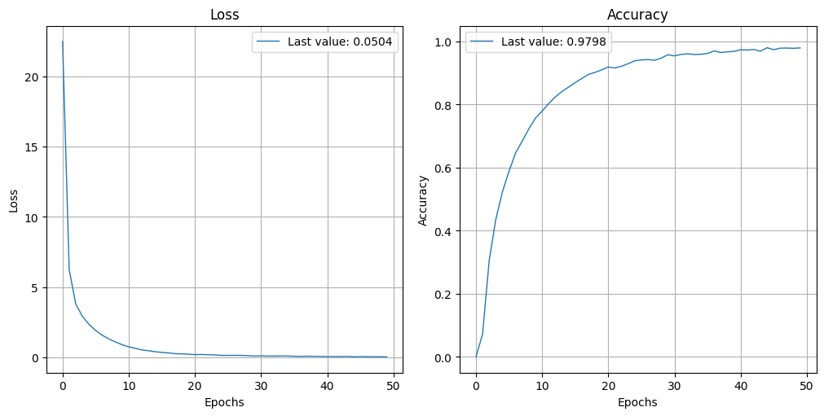
Training
Loss
Accuracy

Slide 24
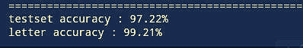
Test
We implemented a function to measure our test set and letter accuracy

Slide 25
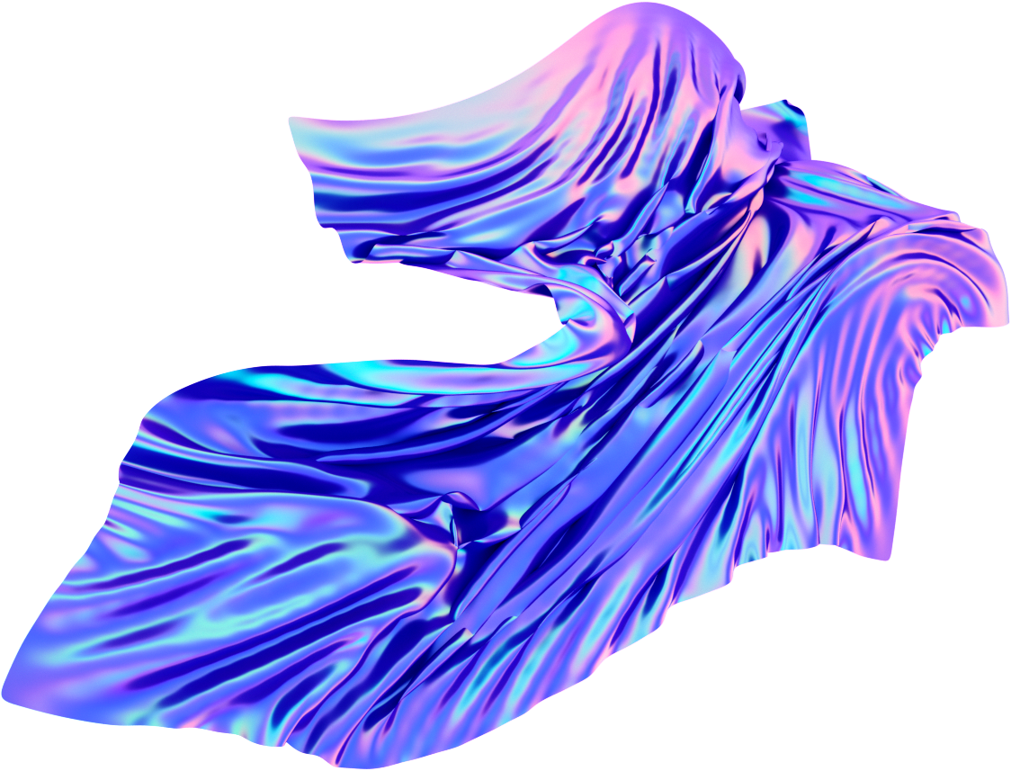
Final System

Slide 26

System Pipeline
Plate Detection
Plate Reading
Database
We used transfer learning to fine tune an object detection (YOLOv7) model.
Then, it's passed to our model so that it can read the plates.
Finally, the plate's numbers are sent to the database to check if it's in it or not.

Slide 27
System Pipeline
Plate Detection
Plate Reading
Database
We used transfer learning to fine tune an object detection (YOLOv7) model.
Then, it's passed to our model so that it can read the plates.
Finally, the plate's numbers are sent to the database to check if it's in it or not.

Slide 28
System Pipeline
Plate Detection
Plate Reading
Database
We used transfer learning to fine tune an object detection (YOLOv7) model.
Then, it's passed to our model so that it can read the plates.
Finally, the plate's numbers are sent to the database to check if it's in it or not.

Slide 29

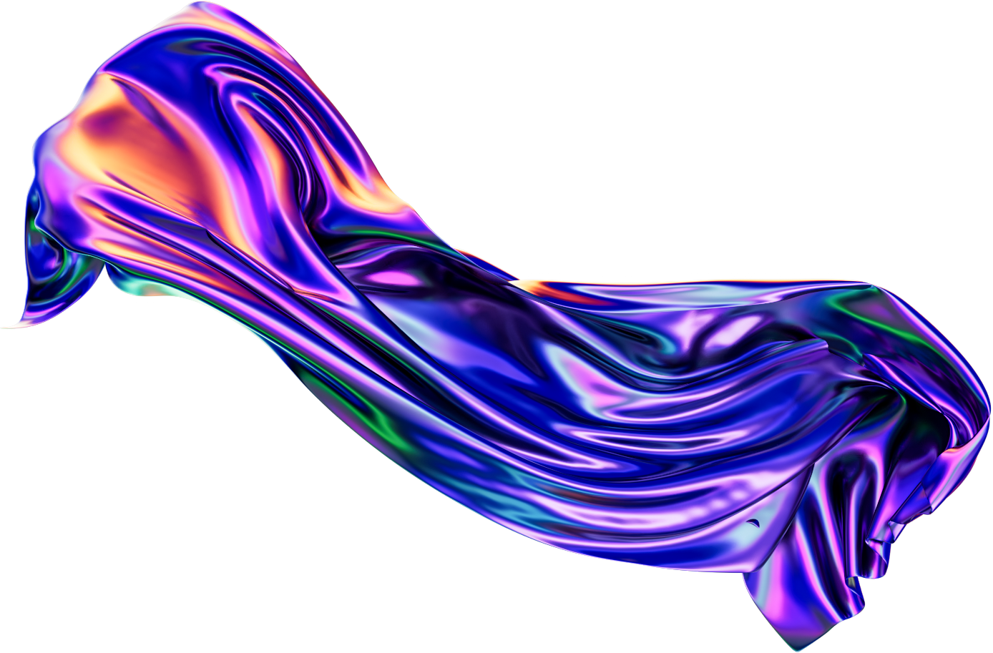


GUI

Slide 30
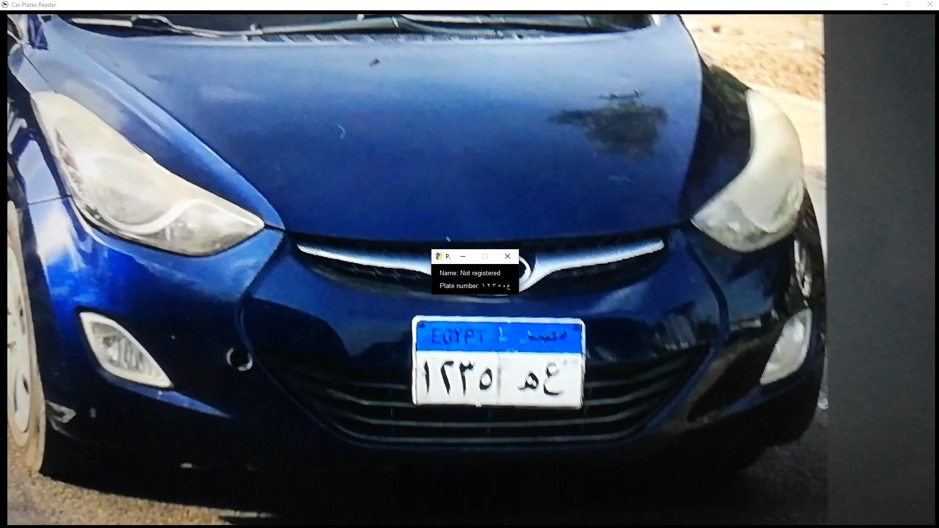

Slide 31
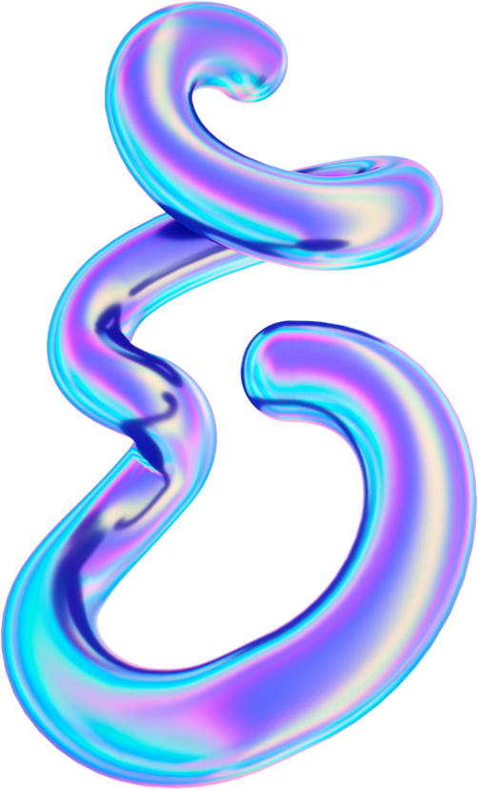
Team
Abdelrahman
Wael
ID: 94109
Eslam
Mohamed
ID: 94222
Fady Amr
ID: 94304
Ahmed
Elsayed
ID: 94215
Muhammad
Usammah
ID: 94284

Slide 32
Thank You

